Slide 1

Title: WeatherIO – A Modern Weather Application
B.B.S Groups of Institutions
& Technology
Subtitle: Real-time Weather Information for Every Location.
Presented by:
Anu Tiwari
Shikha Singh
Ashta Maurya
Under the supervision:-
Aman Sharma
(Lecturer Computer Science, Project Coordinator)
Notes:
NOTE:
To change the image on this slide, select the picture and delete it. Then click the Pictures icon in the placeholder to insert your own image.

Slide 2
Introduction to Weather
What is Weather?
Daily changes in temperature, precipitation, wind, and atmospheric conditions.
Weather is influenced by air pressure, temperature, and moisture.
Key Factors:
Atmospheric Pressure
Temperature and Latitude
Moisture Content

Slide 3
About the Project
WeatherIO is a responsive web application that provides real-time weather updates.
Features:
Current weather conditions with temperature, icons, and descriptions.
5-day weather forecast.
Sunrise, sunset timings, wind speed, air quality, and humidity.
Hourly updates for the current day.
Tools Used:
Software: Visual Studio
Languages: HTML, CSS, JavaScript

Slide 4
Features of WeatherIO
Real-time weather updates with visual icons.
User-friendly search for cities.
5-day forecast and hourly updates.
Sunrise/Sunset times.
Weather conditions like humidity, air quality, visibility, etc.

Slide 5
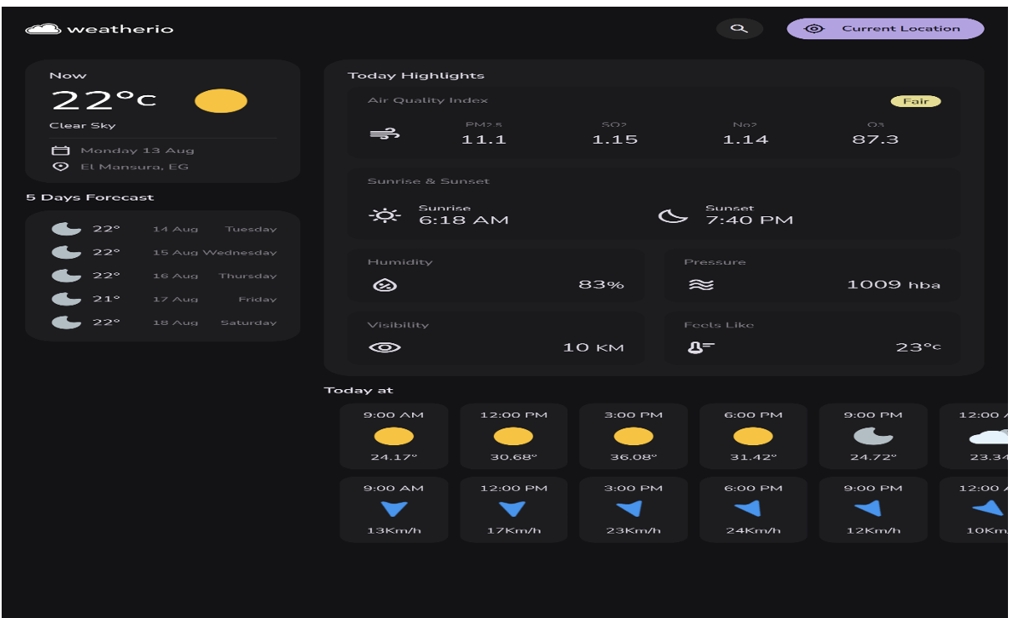
Snapshots of the Project

Slide 6
Project Structure
Files and Directories:index.html: Main page
CSS:
style.css – Application styling
media-query.css – Responsive design
JavaScript:
app.js – Core logic
api.js – API handling
Assets: Weather icons and logos

Slide 7
API Integration
Weather data is fetched using OpenWeather API
Steps:
User enters city/location.
API fetches real-time JSON data.
UI dynamically updates weather details.

Slide 8
Future Scope
Integration of Machine Learning for future weather predictions.
Natural disaster predictions for selected locations.
Display of international/local time using API.
Addition of top weather headlines nearby.
Historical 10-day weather trends for cities.

Slide 9
Challenges and Solutions
Challenge: API errors or unavailable data.
Solution:
Display error messages for failed API requests.
Fallback to last available data.

Slide 10
Conclusion
Summary: WeatherIO simplifies weather tracking with a clean interface and real-time data.
Future Improvements:
Machine learning integration
Disaster predictions
Improved user experience

Slide 11
Thank You

